Slide 1
WIPRO CAPSTONE PROJECT SD-APR-C22 GROUP-4
“SHOP-FOR-HOME”
PRESENTED BY :
Abhinav Singh
Nisarga Sanjay Harale
B.V.Jagadeeswara Rao

Slide 2
ABSTraCT
Furniture items, sofa & beds Home appliances, etc.. ordering is a form of e-commerce which allows customers to directly buy goods from a seller over the internet using a web browser.
Customer can find a product based on type of categories and also by visiting the website and searching among alternative products using a shopping search functionalities, which displays the same products availability and pricing at different e-retailers.

Slide 3

INTRODUCtioN
The Shop For Home project is an application which is based on managing the furniture items and sell the furniture items online.
The main purpose for developing this project in Angular and Java Spring Boot is to manage all the details about furniture item, furniture item category, company, order, sales etc.

Slide 4

INTRODUCtiON
There are two categories of user available in this project. First one is admin and second one is user. Admin can add furniture item category and can also manage the sales details.
This Angular project
sales
very helpful for activity in furniture
maintaining the
item.Project customer can see the details of furniture item category etc.
Only Admin can add the products.

Slide 5

USER FUNCTIONALITIES:
As a user I should be able to login, Logout and Register into the application.
As a user I should be able to see the products in different categories.
As a user I should be able to sort the products.
As a user I should be able to add the products into the shopping cart.
As a user I should be able to increase or decrease the quantity added in the cart.
As a user I should be able to add “n” number of products in the cart.
As a user I should be able to get the Wishlist
option where I can add those products which I want but don’t want to order now
As a user I should get different discount coupon

Slide 6
ADMIN FUNCTIONALITIES:
As an Admin I should be able to
login,
Logout and Register intothe application.
As an Admin I should be able to perform CRUD on Users.
As an Admin I should be able to Perform CRUD on the products.
As an Admin I should be able to get bulk upload option to upload a csv for products details
As an Admin I should be able to get the stocks.
As an Admin I should be able to mail if any stock is less than 10.
As an Admin I should be able to get the sales report.
As an Admin I should be able to set roles of users.

Slide 7
TECHNOLOGIES USED
TypeScript
SPRING BOOT
MYSQL
ANGULAR
HTML
CSS
Visual Studio Code

Slide 8
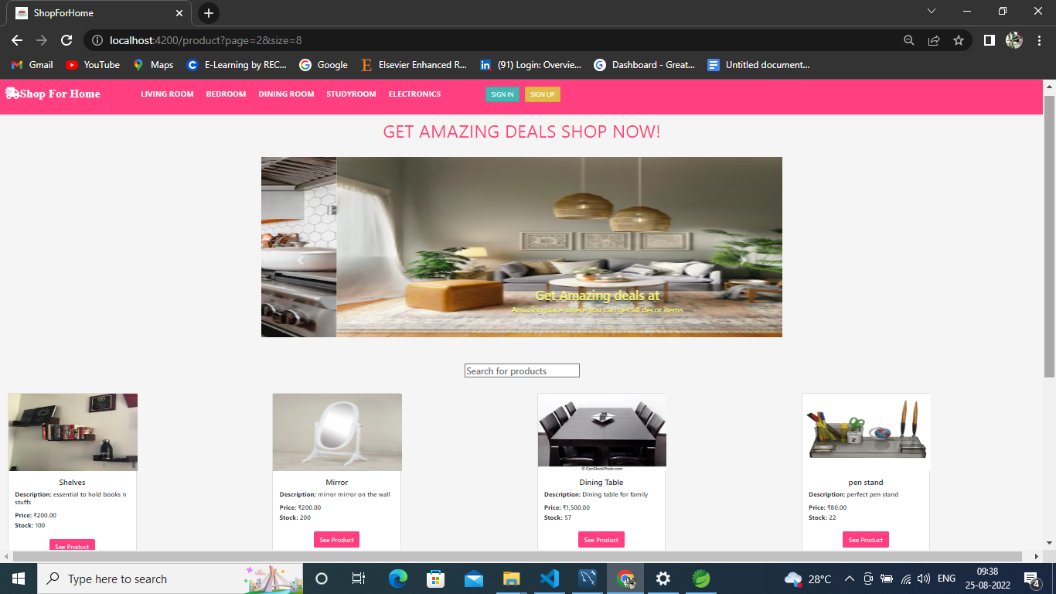
HOME PAGE

Slide 9
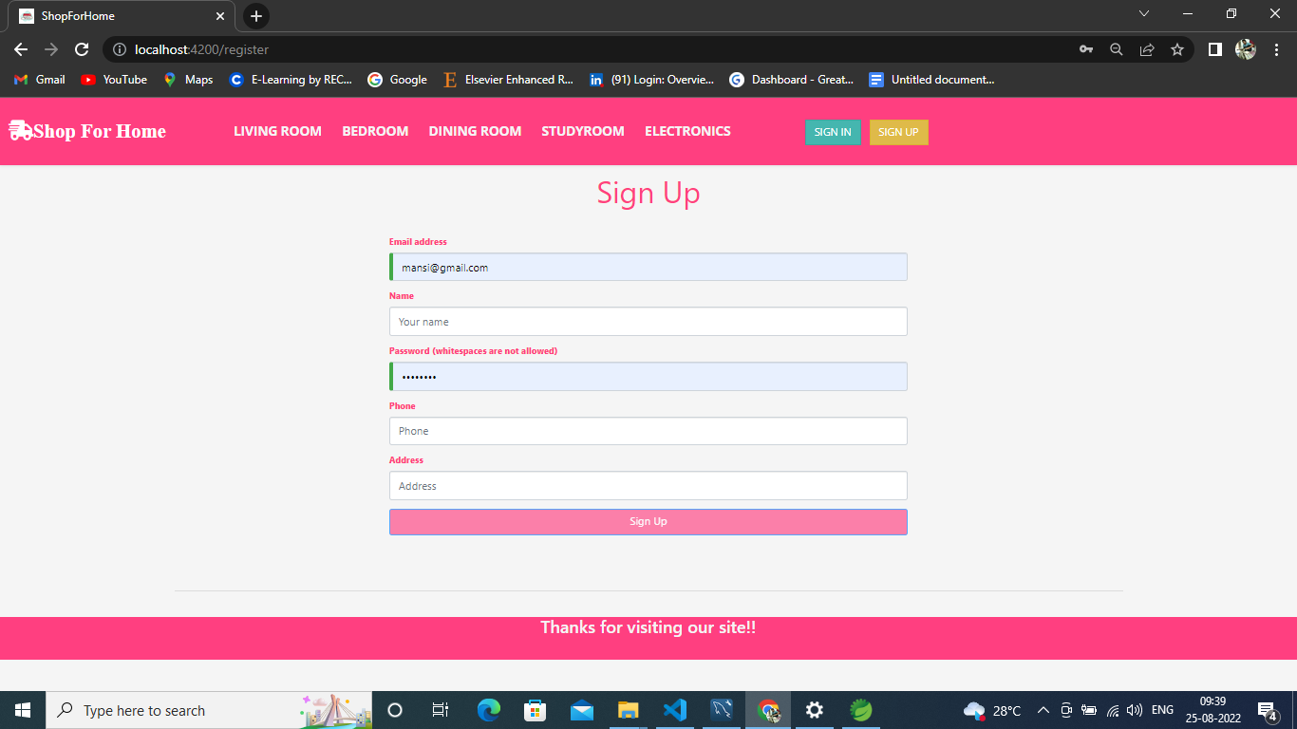
REGISTER

Slide 10
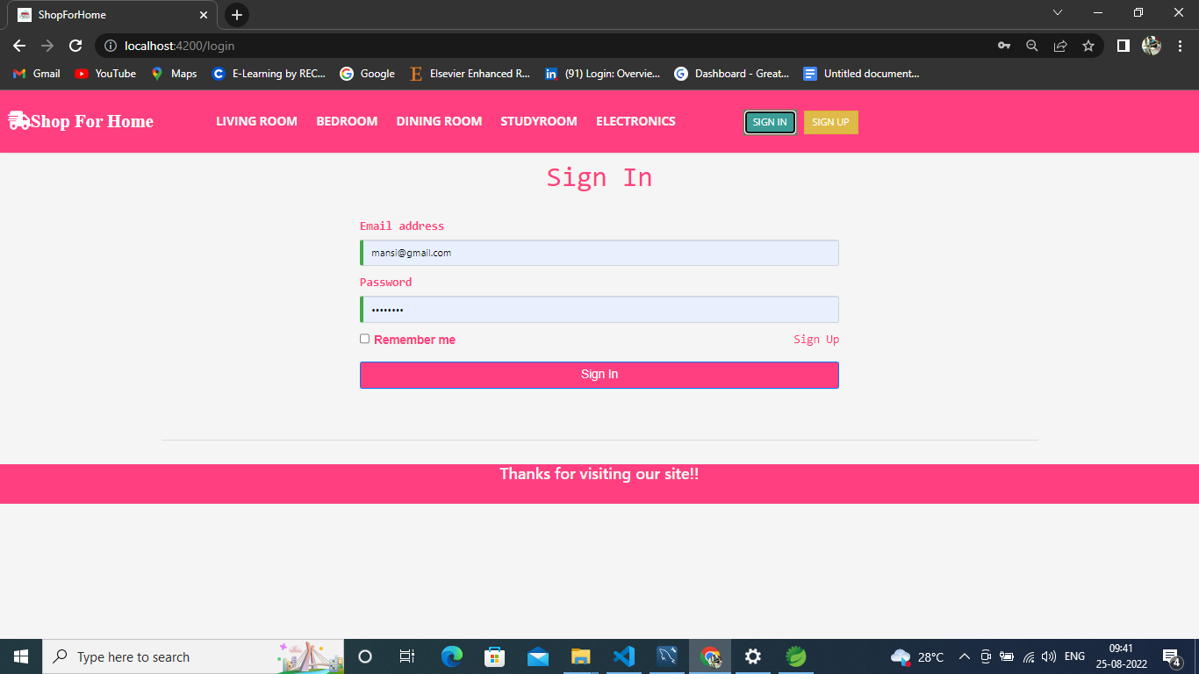
LOGIN
sd 1

Slide 11
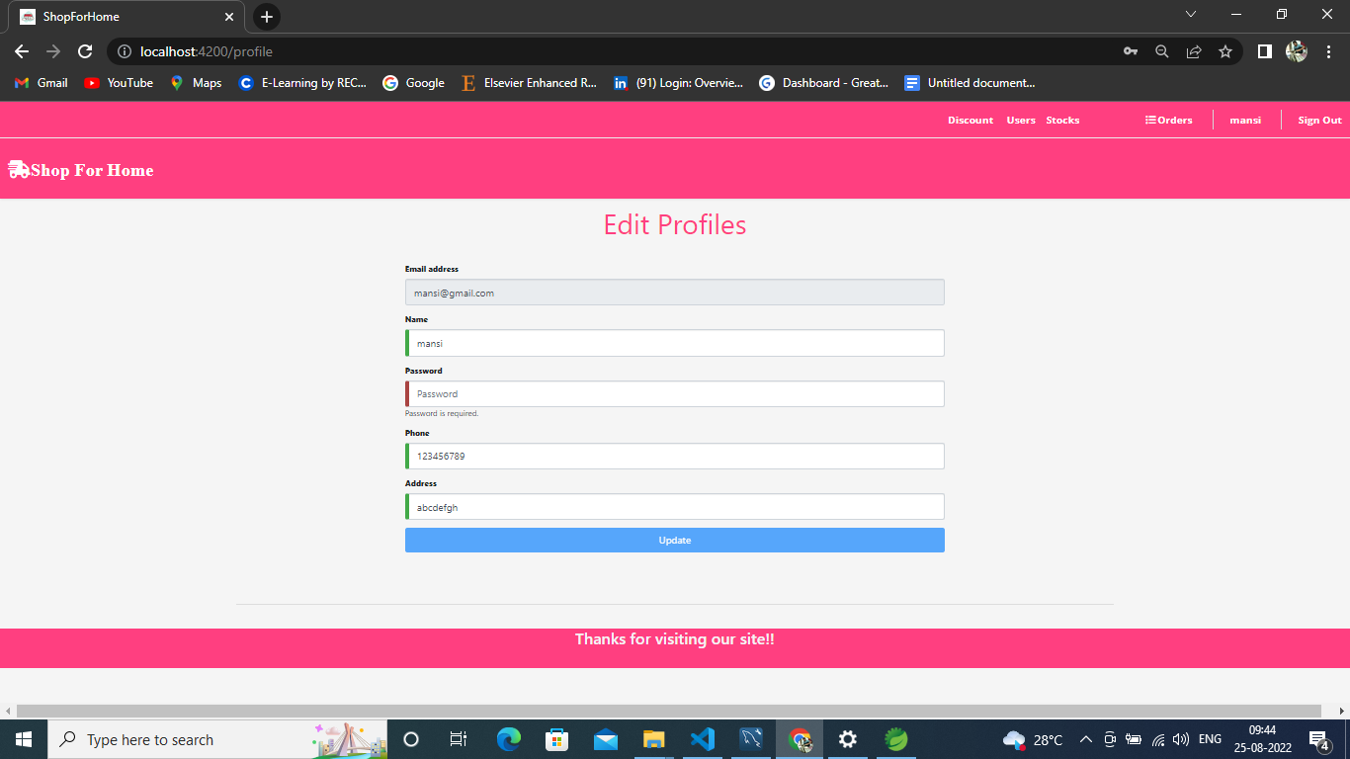
PROFILE EDIT

Slide 12
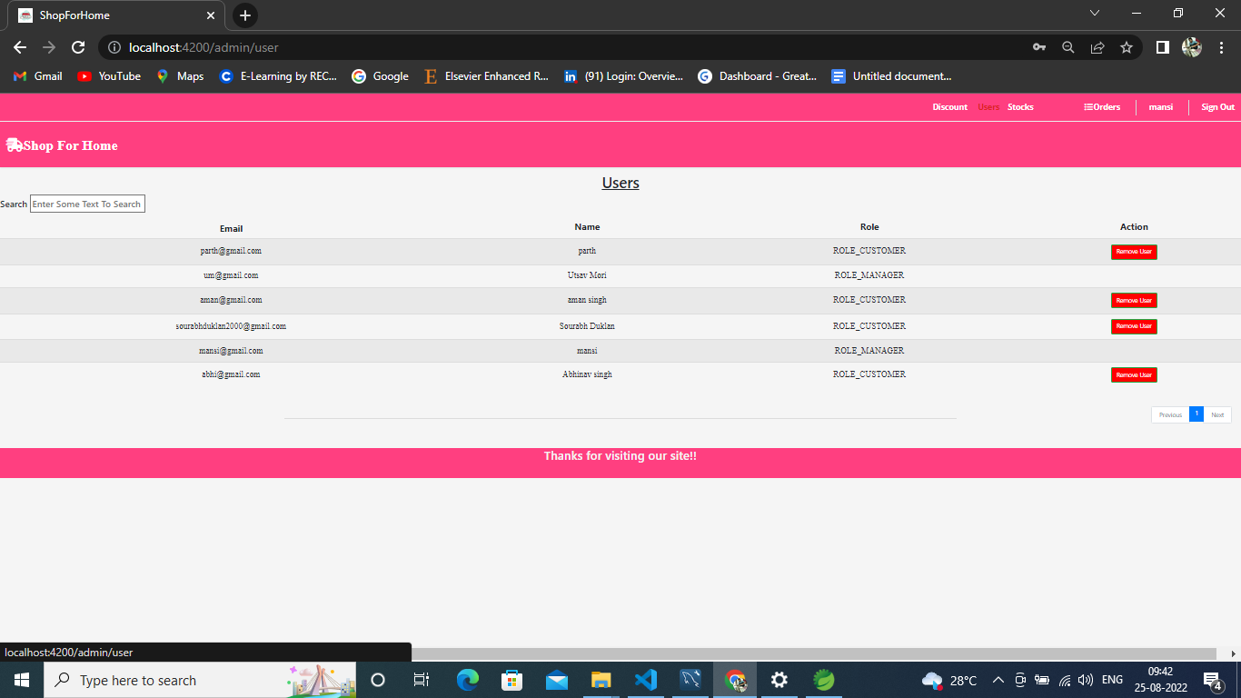
USER LIST TO ADMIN

Slide 13
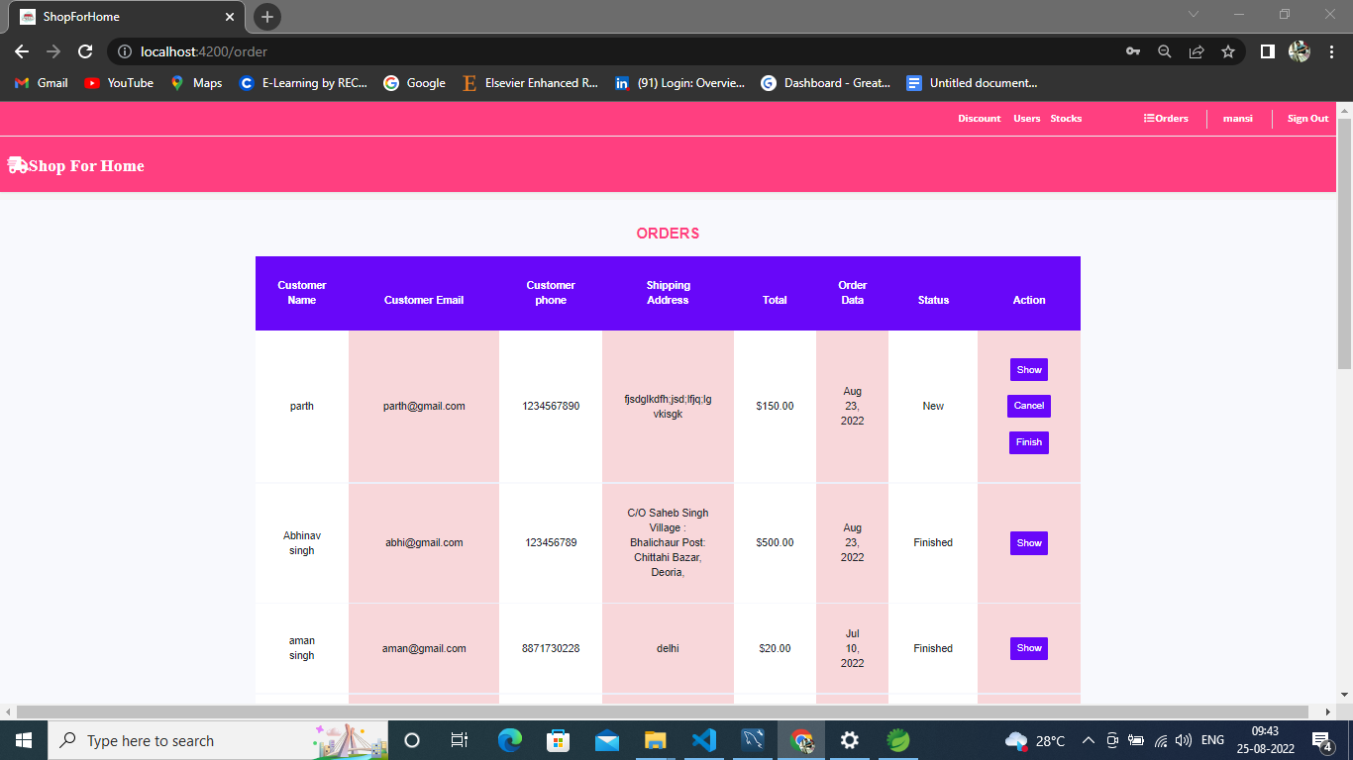
Admin order list

Slide 14
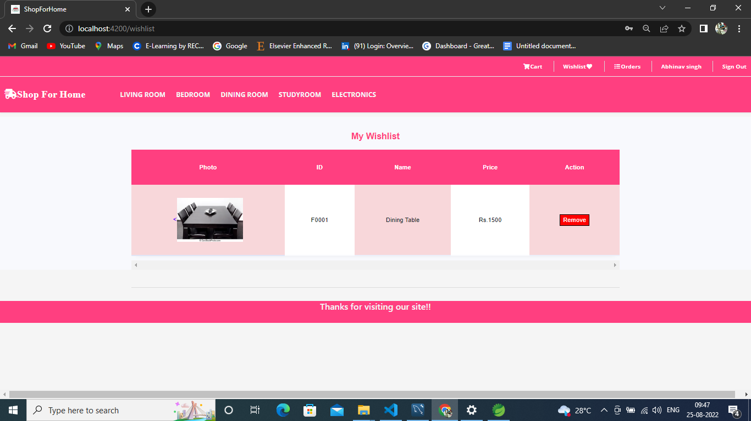
WISHLIST

Slide 15
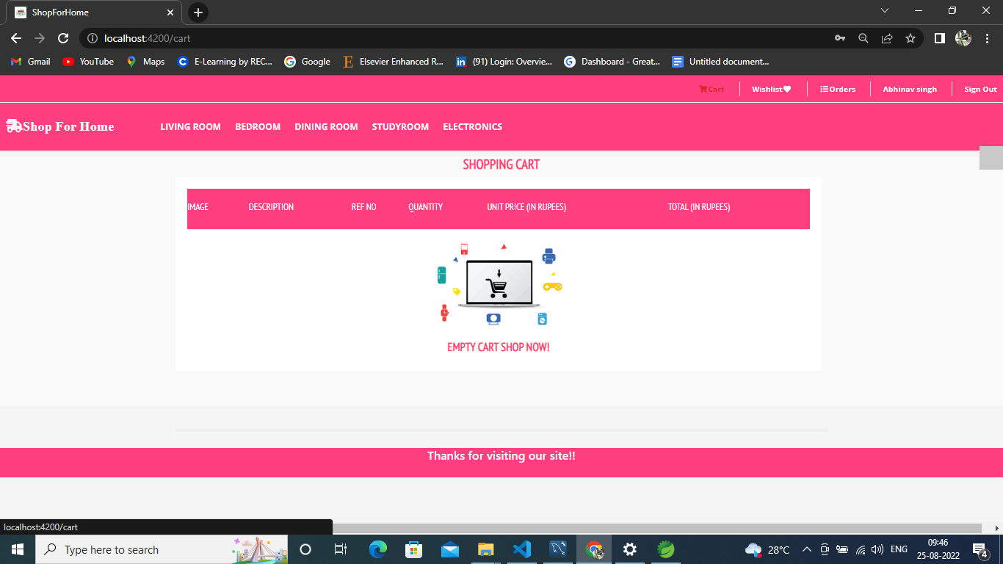
ADD TO CART

Slide 16
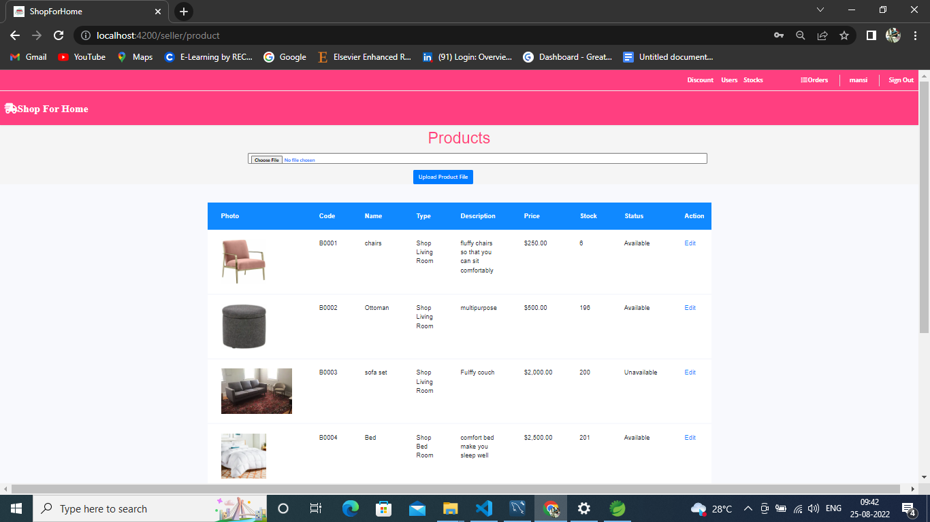
Stock

Slide 17
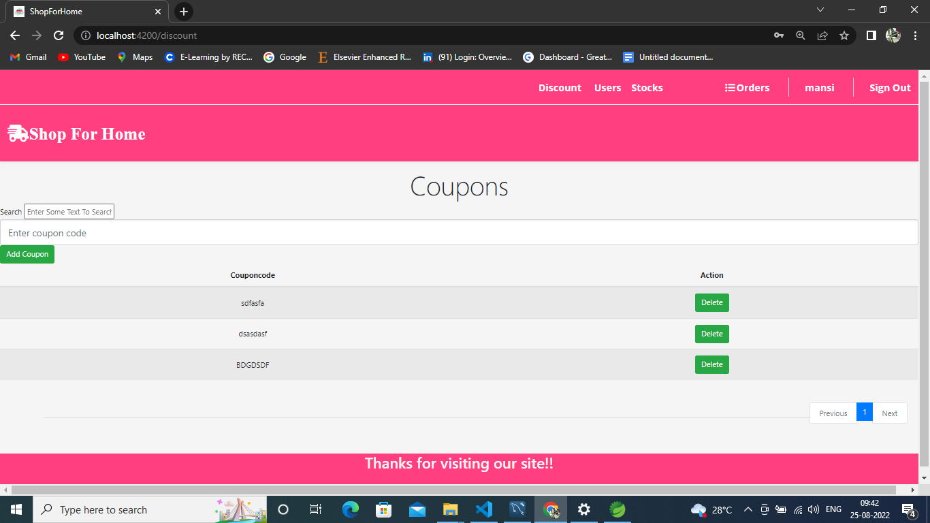
COUPONS

Slide 18
THANK YOU

